Slide 1
Predicting Maximum Credit Before Loan Default
Phase 2 Presentation
Adam Raabe
Vishnu Vardhan Reddy Putha
Pranav Tanaji Ghadge

Slide 2
Project Summary:
Context:
A bank is determining to authorize or deny an applicant’s request for a loan
Goals:
(1) Determine whether an individual should be considered safe from default
(2) Determine what the maximum amount of credit he/she could receive before being unable to return the full quantity of the loan
Methodology:
Step 1: Classify a loan as Default or Fully Paid
Step 2: Determine the approximate maximum loan amount

Slide 3
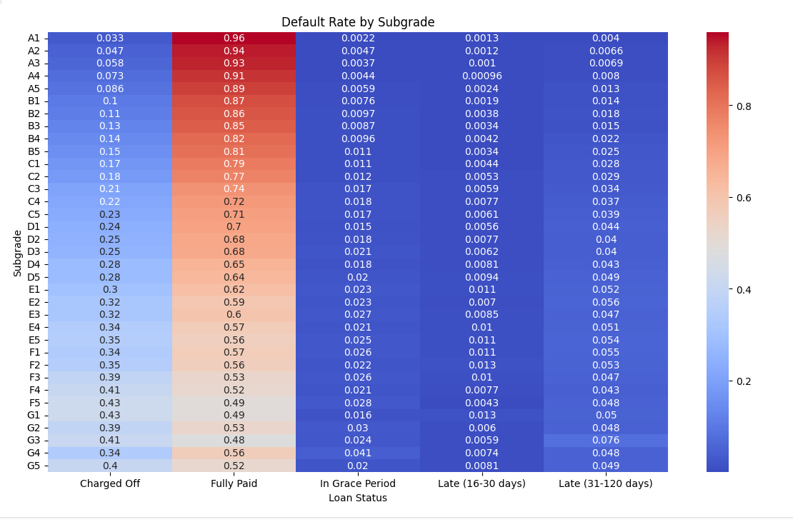
EDA Highlights

Slide 4
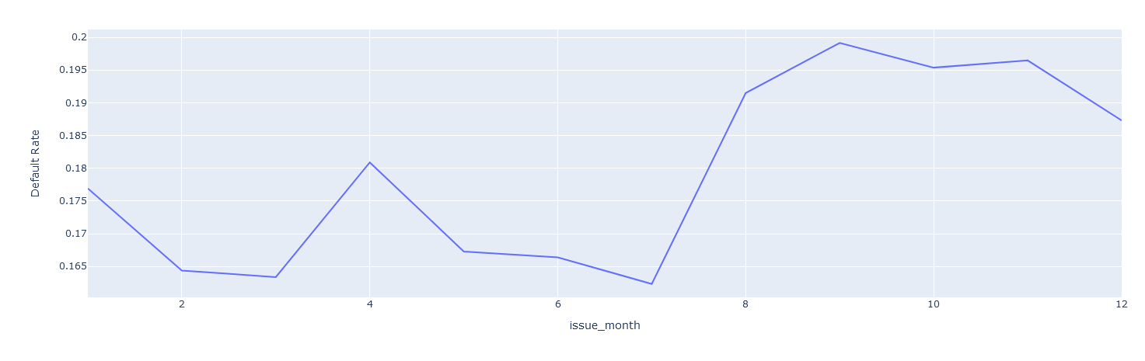
EDA Highlights

Slide 5
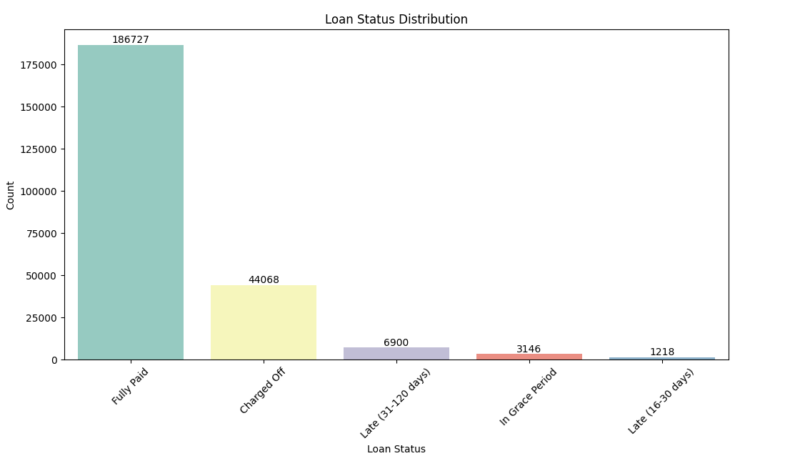
EDA Highlights

Slide 6
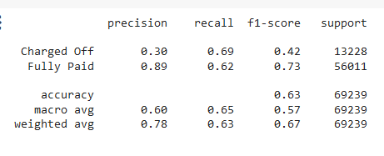
Step 1: Classification Models Tested:
Logistic Regression
Decision Trees
Random Foresting
Support Vector Classification
Extreme Gradient Boosting
Bagging of All Varieties
Voting Between All Varieties
The best results came from Random Foresting and XGBoosting. While bagging and voting were equivalent, they were far slower to calculate.
XGBoost Classification Report

Slide 7
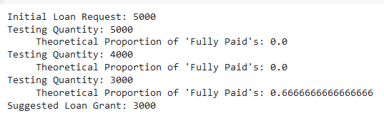
Step 2: Maximization Model: Iterative Stepping
Method 1: Iterative Stepping
Justification:
A working model will eventually declare something fully payable at a lower amount, so just rerun the model with smaller values.
Assumption:
The model works, and inaccuracies can be ameliorated by checking the model results in a small range around any point

Slide 8
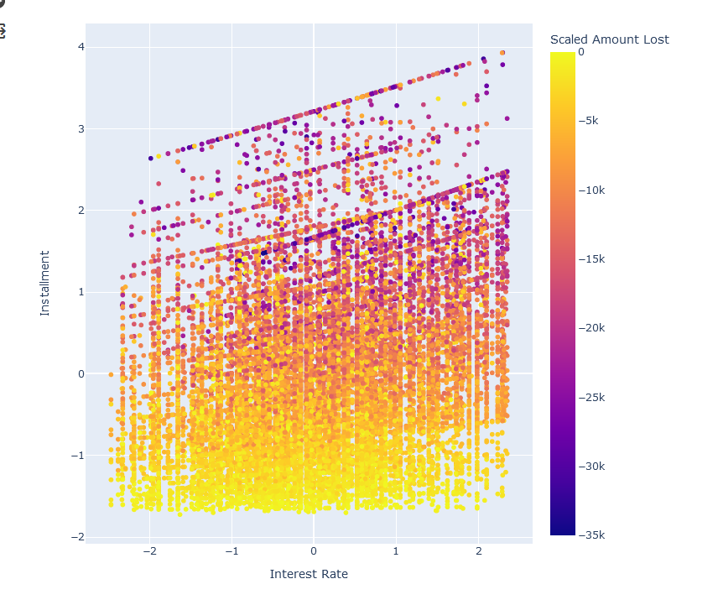
Step 2 Maximization Model Tested: Linear Regression
Method 2: Linear Regression of Expected Loss
Justification:
A general trend that the higher your interest rate and installment, the more money you will lose for the bank.
Assumption:
If we can model how much we lose from the loan, then subtract that amount from the initial request, the bank will lose nothing.

Slide 9
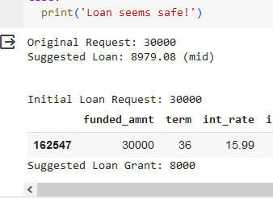
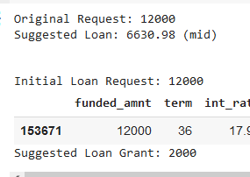

Example Results:

Slide 10
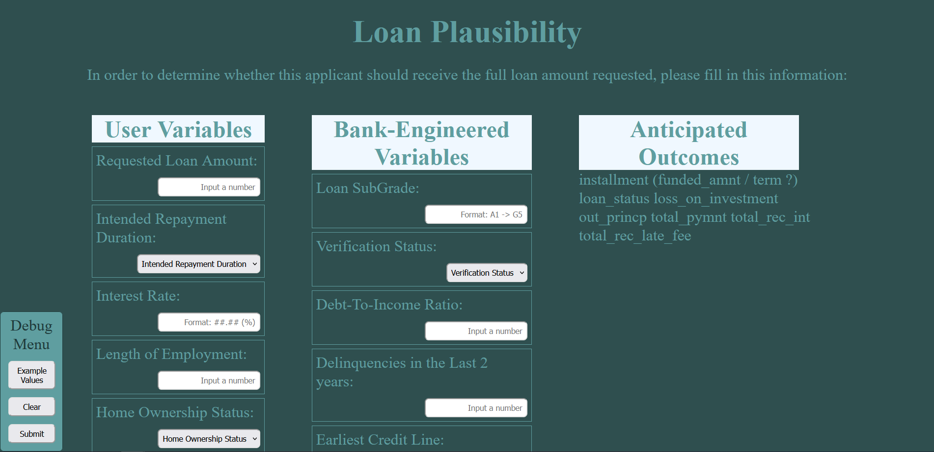
Presentation of Information

